Slide 1
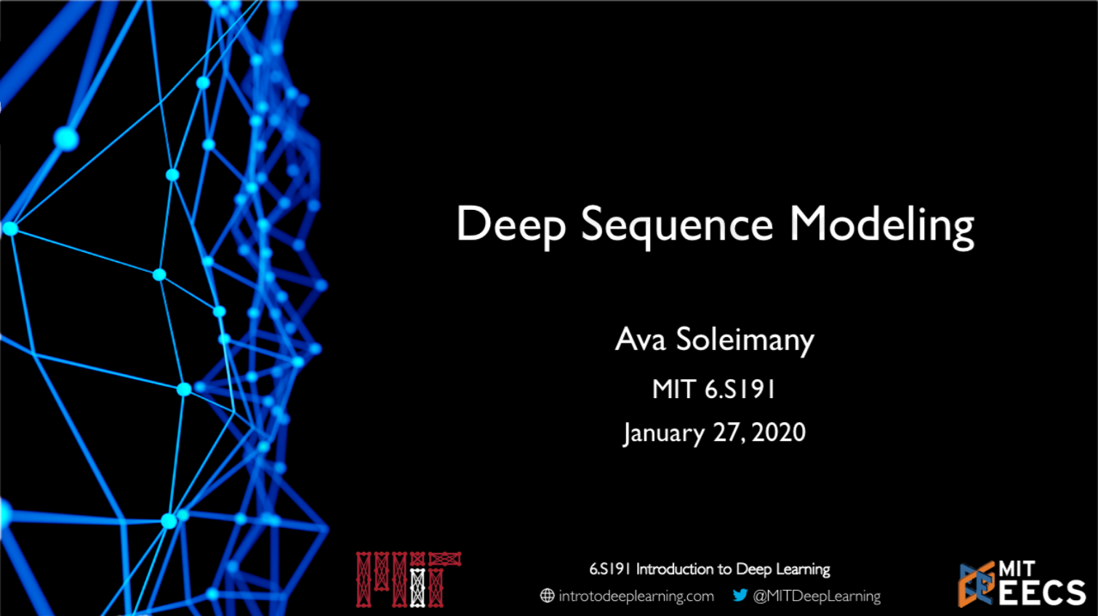

Slide 2
Given an image of a ball, can you predict where it will go next?

Slide 3
Given an image of a ball, can you predict where it will go next?
???

Slide 4
Given an image of a ball, can you predict where it will go next?

Slide 5
Given an image of a ball, can you predict where it will go next?

Slide 6
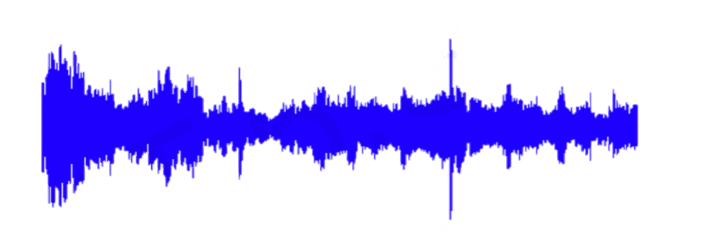
Sequences in the Wild
Audio

Slide 7
Sequences in the Wild
Character:
6 . S 1 9 1
6.S191 Introduction to Deep Learning
Word:
Introduction to Deep Learning
Text

Slide 8
A Sequence Modeling Problem: Predict the Next Word

Slide 9
A Sequence Modeling Problem: Predict the Next Word
“This morning I took my cat for a walk.”

Slide 10
A Sequence Modeling Problem: Predict the Next Word
“This morning I took my cat for a walk.”
given these words

Slide 11
A Sequence Modeling Problem: Predict the Next Word
“This morning I took my cat for a walk.”
given these words
predict the next word

Slide 12
Idea #1: Use a Fixed Window
“This morning I took my cat for a walk.”
given these two words
predict the next word

Slide 13
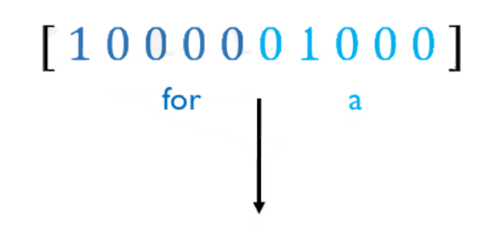
Idea #1: Use a Fixed Window
“This morning I took my cat for a walk.”
given these two words
predict the next word
One hot feature encoding: tell us what each word is
Prediction

Slide 14

Problem #1: Can’t Model Long-Term Dependencies
“France is where I grew up, but I now live in Boston. I speak fluent __.”
We need information from the distant past to accurately predict the correct word.

Slide 15
Idea #2: Use Entire Sequence as a Set of Counts
“This morning I took my cat for a”
“bag of words”
[0100100 … 00110001]
prediction

Slide 16


Problem #2: Counts Don’t Preserve Order
The food was good, not bad at all.
V.S.
The food was bad, not good at all.

Slide 17
Idea #3: Use a Really Big Fixed Window
“This morning I took my cat for a walk.”
given these words
predict the next word
[1000000001001000100000010 … ]
Morning
I
Took
This
Cat
Prediction

Slide 18
Problem #3: No Parameter Sharing
[1000000001001000100000010 … ]
This
Morning
Took
The
Cat
Each of these inputs has a separate parameter:

Slide 19
Problem #3: No Parameter Sharing
[1000000001001000100000010 … ]
This
Morning
Took
The
Cat
Each of these inputs has a separate parameter:
[0001000100010001000000001 … ]
This
Morning

Slide 20
Problem #3: No Parameter Sharing
[1000000001001000100000010 … ]
This
Morning
Took
The
Cat
Each of these inputs has a separate parameter:
[0001000100010001000000001 … ]
This
Morning
Things we learn about the sequence won’t transfer if they appear elsewhere in the sequence.

Slide 21
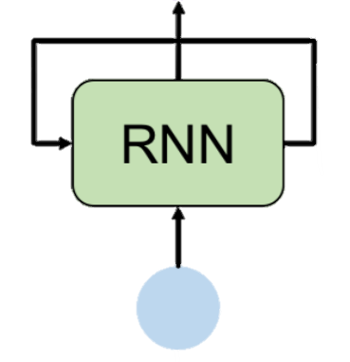
Sequence Modeling: Design Criteria
To model sequences, we need to:
Handle variable length sequences
Track long-term dependencies
Maintain information about order
Share parameters across the sequence
Today: Recurrent Neural Networks (RNNs) as an approach to sequence modeling problems

Slide 22
Recurrent Neural Networks (RNNs)

Slide 23
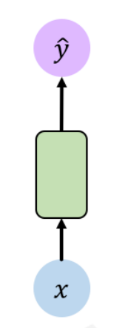
Standard Feed-Forward Neural Network
One to One
“Vanilla” neural network

Slide 24
Recurrent Neural Networks for Sequence Modeling
One to One
“Vanilla” neural network
Many to One
Sentiment Classification

Slide 25
Recurrent Neural Networks for Sequence Modeling
One to One
“Vanilla” neural network
Many to One
Sentiment Classification
Many to Many Music Generation

Slide 26
Recurrent Neural Networks for Sequence Modeling
… and many other architectures and applications.
One to One
“Vanilla” neural network
Many to One
Sentiment Classification
Many to Many Music Generation

Slide 27
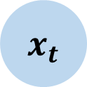
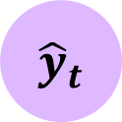
Standard “Vanilla” Neural Network
$${ \hat{y}}_{t}$$
Output Vector
Input Vector
$${ x}_{t}$$

Slide 28
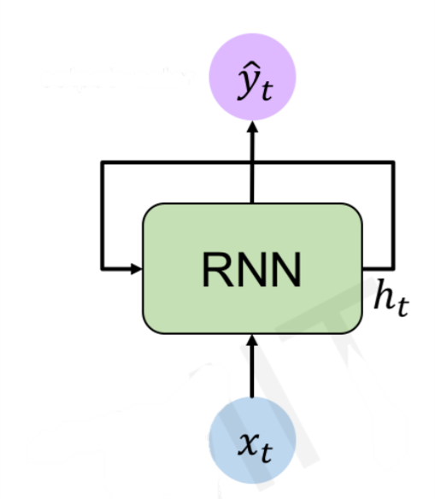
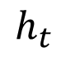
Recurrent Neural Network (RNN)
$${ \hat{y}}_{t}$$
Output Vector
RNN
$$h_{t}$$
Input Vector
$${ x}_{t}$$

Slide 29
Recurrent Neural Network (RNN)
$${ \hat{y}}_{t}$$
Output Vector
RNN
recurrent cell
$$h_{t}$$
Input Vector
$${ x}_{t}$$

Slide 30
Recurrent Neural Network (RNN)
$${ \hat{y}}_{t}$$
Apply a recurrence relation at every time step to process a sequence:
Output Vector
RNN
recurrent cell
$$h_{t}$$
Input Vector
$${ x}_{t}$$

Slide 31
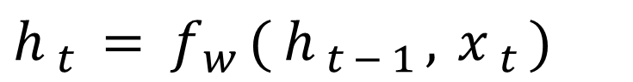
Recurrent Neural Network (RNN)
$${ \hat{y}}_{t}$$
Apply a recurrence relation at every time step to process a sequence:
Output Vector
$h_{t}=f_{w}(h_{t−1},x_{t})$
RNN
recurrent cell
$$h_{t}$$
Cell State
Function parameterized by w
Old State
Input vector at time state t
Input Vector
$${ x}_{t}$$

Slide 32
Recurrent Neural Network (RNN)
$${ \hat{y}}_{t}$$
Apply a recurrence relation at every time step to process a sequence:
Output Vector
$h_{t}=f_{w}(h_{t−1},x_{t})$
RNN
recurrent cell
$$h_{t}$$
Cell State
Function parameterized by w
Old State
Input vector at time state t
Input Vector
$${ x}_{t}$$
Note: the same function and set of parameters are used at ever time step.

Slide 33
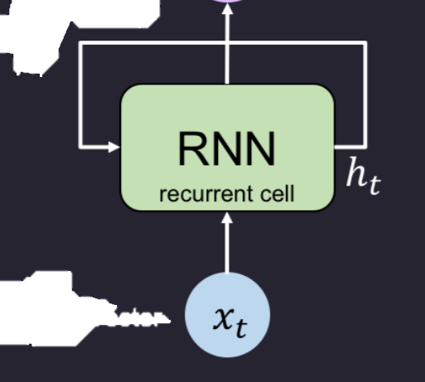
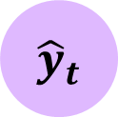
RNN Intuition
my_rnn = RNN()
hidden_state = [ 0, 0, 0, 0 ]
sentence = [“I”, “love”, “recurrent”, “neural”]
for word in sentence:
prediction, hidden_state = my_rnn(word, hidden_state)
next_word_prediction = prediction
# >>> “networks!”
$${ \hat{y}}_{t}$$
Output Vector
Input Vector

Slide 34
RNN Intuition
my_rnn = RNN()
hidden_state = [ 0, 0, 0, 0 ]
sentence = [“I”, “love”, “recurrent”, “neural”]
for word in sentence:
prediction, hidden_state = my_rnn(word, hidden_state)
next_word_prediction = prediction
# >>> “networks!”
$${ \hat{y}}_{t}$$
Output Vector
Input Vector

Slide 35
RNN Intuition
my_rnn = RNN()
hidden_state = [ 0, 0, 0, 0 ]
sentence = [“I”, “love”, “recurrent”, “neural”]
for word in sentence:
prediction, hidden_state = my_rnn(word, hidden_state)
next_word_prediction = prediction
# >>> “networks!”
$${ \hat{y}}_{t}$$
Output Vector
Input Vector

Slide 36
RNN State Update and Output
$${ \hat{y}}_{t}$$
Output Vector
RNN
recurrent cell
$$h_{t}$$
Input Vector
$${ x}_{t}$$

Slide 37
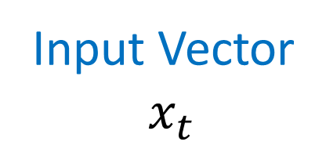
RNN State Update and Output
Output Vector
RNN
recurrent cell
$$h_{t}$$
Input Vector
$$x_{t}$$
Input Vector
$${ x}_{t}$$

Slide 38
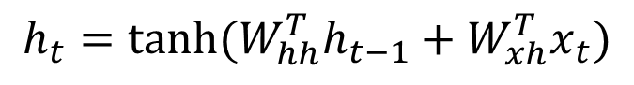
RNN State Update and Output
$${ \hat{y}}_{t}$$
Output Vector
RNN
Update Hidden State
recurrent cell
$$h_{t}$$
$$h_{t}=\tanh{{(W}_{hh}^{T}h_{t−1}+W_{xh}^{T}x_{t})}$$
Input Vector
$$x_{t}$$
Input Vector
$${ x}_{t}$$

Slide 39
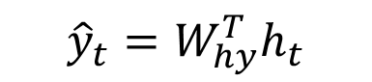
RNN State Update and Output
$${ \hat{y}}_{t}$$
Output Vector
Output Vector
$${\hat{y}}_{t}=W_{hy}^{T}h_{t}$$
RNN
Update Hidden State
recurrent cell
$$h_{t}$$
$$h_{t}=\tanh{{(W}_{hh}^{T}h_{t−1}+W_{xh}^{T}x_{t})}$$
Input Vector
$$x_{t}$$
Input Vector
$${ x}_{t}$$

Slide 40
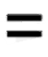
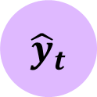

RNNs: Computational Graph Across Time
$${ \hat{y}}_{t}$$
RNN
Represent as a computational graph unrolled across time
$${ x}_{t}$$

Slide 41
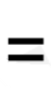
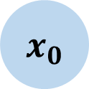
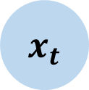
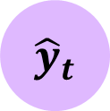
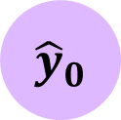
RNNs: Computational Graph Over Time
$${ \hat{y}}_{t}$$
$${ \hat{y}}_{0}$$
RNN
$${ x}_{t}$$
$${ x}_{0}$$

Slide 42
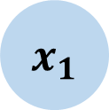
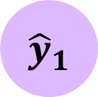
RNNs: Computational Graph Over Time
$${ \hat{y}}_{t}$$
$${ \hat{y}}_{0}$$
$${ \hat{y}}_{1}$$
RNN
$${ x}_{t}$$
$${ x}_{0}$$
$${ x}_{1}$$

Slide 43
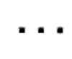
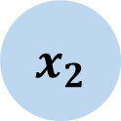
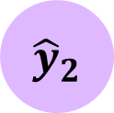
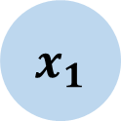
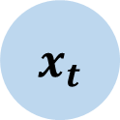
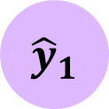
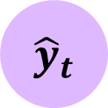
RNNs: Computational Graph Over Time
$${ \hat{y}}_{t}$$
$${ \hat{y}}_{0}$$
$${ \hat{y}}_{1}$$
$${ \hat{y}}_{2}$$
$${ \hat{y}}_{t}$$
RNN
$${ x}_{t}$$
$${ x}_{0}$$
$${ x}_{1}$$
$${ x}_{2}$$
$${ x}_{t}$$

Slide 44
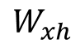
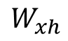
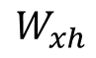
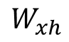
RNNs: Computational Graph Over Time
$${ \hat{y}}_{t}$$
$${ \hat{y}}_{0}$$
$${ \hat{y}}_{1}$$
$${ \hat{y}}_{2}$$
$${ \hat{y}}_{t}$$
RNN
$$W_{xh}$$
$$W_{xh}$$
$$W_{xh}$$
$$W_{xh}$$
$${ x}_{t}$$
$${ x}_{0}$$
$${ x}_{1}$$
$${ x}_{2}$$
$${ x}_{t}$$

Slide 45
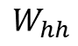
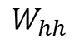
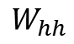
RNNs: Computational Graph Over Time
$${ \hat{y}}_{t}$$
$${ \hat{y}}_{0}$$
$${ \hat{y}}_{1}$$
$${ \hat{y}}_{2}$$
$${ \hat{y}}_{t}$$
RNN
$$W_{hh}$$
$$W_{hh}$$
$$W_{hh}$$
$$W_{xh}$$
$$W_{xh}$$
$$W_{xh}$$
$$W_{xh}$$
$${ x}_{t}$$
$${ x}_{0}$$
$${ x}_{1}$$
$${ x}_{2}$$
$${ x}_{t}$$

Slide 46
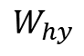
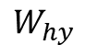
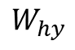
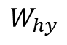
RNNs: Computational Graph Over Time
$${ \hat{y}}_{t}$$
$${ \hat{y}}_{0}$$
$${ \hat{y}}_{1}$$
$${ \hat{y}}_{2}$$
$${ \hat{y}}_{t}$$
$$W_{hy}$$
$$W_{hy}$$
$$W_{hy}$$
$$W_{hy}$$
RNN
$$W_{hh}$$
$$W_{hh}$$
$$W_{hh}$$
$$W_{xh}$$
$$W_{xh}$$
$$W_{xh}$$
$$W_{xh}$$
$${ x}_{t}$$
$${ x}_{0}$$
$${ x}_{1}$$
$${ x}_{2}$$
$${ x}_{t}$$

Slide 47
RNNs: Computational Graph Over Time
Re-use the same weight matrices at every time step
$${ \hat{y}}_{t}$$
$${ \hat{y}}_{0}$$
$${ \hat{y}}_{1}$$
$${ \hat{y}}_{2}$$
$${ \hat{y}}_{t}$$
$$W_{hy}$$
$$W_{hy}$$
$$W_{hy}$$
$$W_{hy}$$
RNN
$$W_{hh}$$
$$W_{hh}$$
$$W_{hh}$$
$$W_{xh}$$
$$W_{xh}$$
$$W_{xh}$$
$$W_{xh}$$
$${ x}_{t}$$
$${ x}_{0}$$
$${ x}_{1}$$
$${ x}_{2}$$
$${ x}_{t}$$

Slide 48
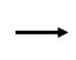
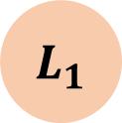
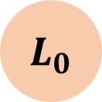
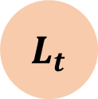
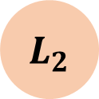
RNNs: Computational Graph Over Time
Forward pass
$${ L}_{0}$$
$${ L}_{1}$$
$${ L}_{2}$$
$${ L}_{t}$$
$${ \hat{y}}_{t}$$
$${ \hat{y}}_{0}$$
$${ \hat{y}}_{1}$$
$${ \hat{y}}_{2}$$
$${ \hat{y}}_{t}$$
$$W_{hy}$$
$$W_{hy}$$
$$W_{hy}$$
$$W_{hy}$$
RNN
$$W_{hh}$$
$$W_{hh}$$
$$W_{hh}$$
$$W_{xh}$$
$$W_{xh}$$
$$W_{xh}$$
$$W_{xh}$$
$${ x}_{t}$$
$${ x}_{0}$$
$${ x}_{1}$$
$${ x}_{2}$$
$${ x}_{t}$$

Slide 49
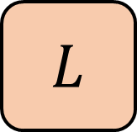
RNNs: Computational Graph Over Time
$$L$$
Forward pass
$${ L}_{0}$$
$${ L}_{1}$$
$${ L}_{2}$$
$${ L}_{t}$$
$${ \hat{y}}_{t}$$
$${ \hat{y}}_{0}$$
$${ \hat{y}}_{1}$$
$${ \hat{y}}_{2}$$
$${ \hat{y}}_{t}$$
$$W_{hy}$$
$$W_{hy}$$
$$W_{hy}$$
$$W_{hy}$$
RNN
$$W_{hh}$$
$$W_{hh}$$
$$W_{hh}$$
$$W_{xh}$$
$$W_{xh}$$
$$W_{xh}$$
$$W_{xh}$$
$${ x}_{t}$$
$${ x}_{0}$$
$${ x}_{1}$$
$${ x}_{2}$$
$${ x}_{t}$$

Slide 50
RNNs From Scratch
class MyRNNCell(tf.keras.layers.Layers):
def __init__(self, rnn_units, input_dim, output_dim):
super(MyRNNCell, self).__init__()
#Initialize weight matrices
self.W_xh = self.add_weight([rnn_units, input_dim])
self.W_hh = self.add_weight([rnn_units, input_dim])
self.W_yh = self.add_weight([input_dim, rnn_units])
#Initialize hidden state to zeros
self.h = tf.zeros([rnn_units, 1])
def call(self, x);
#Update the hidden state
self.h = tf.math.tanh( self.W_hh * self.h + self.W_xh * x )
#Complete the output
output = self.W_hy * self.h
#Return the current output and hidden state
return output, self.h
$${ \hat{y}}_{t}$$
Output Vector
Input Vector

Slide 51
RNN Implementation in TensorFlow
$${ \hat{y}}_{t}$$
Output Vector
tf.keras.layers.SimpleRNN(rnn_units)
Input Vector

Slide 52
Backpropagation Through Time (BPTT)

Slide 53
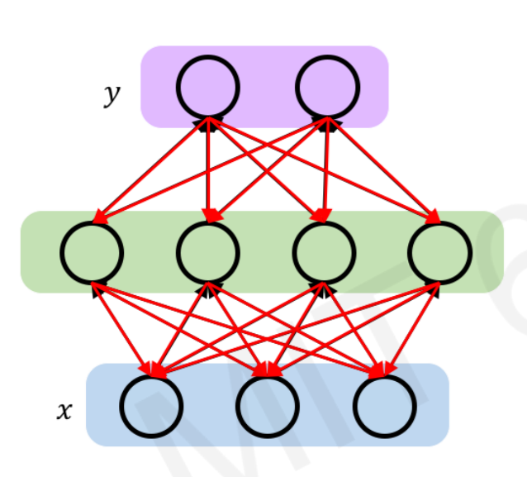


Recall: Backpropagation in Feed Forward Models
Backpropagation algorithm:
Take the derivative (gradient) of the loss with respect to each parameter
Shift parameters in order to minimize loss

Slide 54
RNNs: Backpropagation Through Time
$$L$$
Forward pass
$${ L}_{0}$$
$${ L}_{1}$$
$${ L}_{2}$$
$${ L}_{t}$$
$${ \hat{y}}_{t}$$
$${ \hat{y}}_{0}$$
$${ \hat{y}}_{1}$$
$${ \hat{y}}_{2}$$
$${ \hat{y}}_{t}$$
$$W_{hy}$$
$$W_{hy}$$
$$W_{hy}$$
$$W_{hy}$$
RNN
$$W_{hh}$$
$$W_{hh}$$
$$W_{hh}$$
$$W_{xh}$$
$$W_{xh}$$
$$W_{xh}$$
$$W_{xh}$$
$${ x}_{t}$$
$${ x}_{0}$$
$${ x}_{1}$$
$${ x}_{2}$$
$${ x}_{t}$$

Slide 55
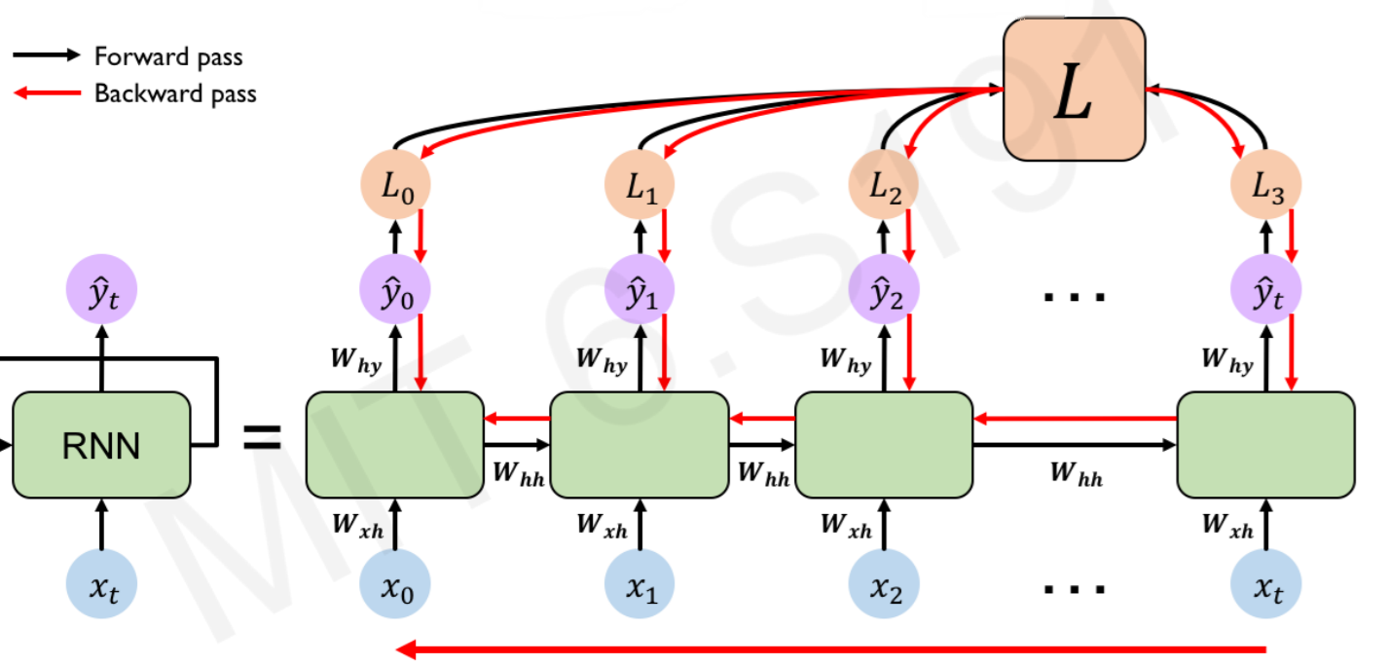
RNNs: Backpropagation Through Time
$$L$$
Forward pass
Backward pass
$${ L}_{0}$$
$${ L}_{1}$$
$${ L}_{2}$$
$${ L}_{t}$$
$${ \hat{y}}_{t}$$
$${ \hat{y}}_{0}$$
$${ \hat{y}}_{1}$$
$${ \hat{y}}_{2}$$
$${ \hat{y}}_{t}$$
$$W_{hy}$$
$$W_{hy}$$
$$W_{hy}$$
$$W_{hy}$$
RNN
$$W_{hh}$$
$$W_{hh}$$
$$W_{hh}$$
$$W_{xh}$$
$$W_{xh}$$
$$W_{xh}$$
$$W_{xh}$$
$${ x}_{t}$$
$${ x}_{0}$$
$${ x}_{1}$$
$${ x}_{2}$$
$${ x}_{t}$$

Slide 56













Standard RNN Gradient Flow
$${ H}_{0}$$
$${ H}_{T}$$
$$W_{hh}$$
$$W_{hh}$$
$$W_{hh}$$
$$W_{xh}$$
$$W_{xh}$$
$$W_{xh}$$
$$W_{xh}$$
$${ x}_{0}$$
$${ x}_{1}$$
$${ x}_{2}$$
$${ x}_{t}$$

Slide 57
Standard RNN Gradient Flow
$${ H}_{0}$$
$${ H}_{T}$$
$$W_{hh}$$
$$W_{hh}$$
$$W_{hh}$$
$$W_{xh}$$
$$W_{xh}$$
$$W_{xh}$$
$$W_{xh}$$
$${ x}_{0}$$
$${ x}_{1}$$
$${ x}_{2}$$
$${ x}_{t}$$
Computing the gradient wrt $h_{0}$ involves many factors of $W_{hh}+$ repeated gradient computation!

Slide 58
Standard RNN Gradient Flow: Exploding Gradients
$${ H}_{0}$$
$${ H}_{T}$$
$$W_{hh}$$
$$W_{hh}$$
$$W_{hh}$$
$$W_{xh}$$
$$W_{xh}$$
$$W_{xh}$$
$$W_{xh}$$
$${ x}_{0}$$
$${ x}_{1}$$
$${ x}_{2}$$
$${ x}_{t}$$
Computing the gradient wrt $h_{0}$ involves many factors of $W_{hh}+$ repeated gradient computation!
Many Values > 1:
exploding gradients
Gradient clipping to
scale big gradients

Slide 59
Standard RNN Gradient Flow: Vanishing Flow
$${ H}_{0}$$
$${ H}_{T}$$
$$W_{hh}$$
$$W_{hh}$$
$$W_{hh}$$
$$W_{xh}$$
$$W_{xh}$$
$$W_{xh}$$
$$W_{xh}$$
$${ x}_{0}$$
$${ x}_{1}$$
$${ x}_{2}$$
$${ x}_{t}$$
Computing the gradient wrt $h_{0}$ involves many factors of $W_{hh}+$ repeated gradient computation!
Many Values > 1:
exploding gradients
Gradient clipping to
scale big gradients
Many Values < 1:
vanishing gradients
Activation function
Weight initialization
Network Architecture

Slide 60
The Problem of Long-Term Dependencies
Why are vanishing gradients a problem?

Slide 61
The Problem of Long-Term Dependencies
Why are vanishing gradients a problem?
Multiply many small numbers together

Slide 62

The Problem of Long-Term Dependencies
Why are vanishing gradients a problem?
Multiply many small numbers together
Errors due to further back time steps have smaller and smaller gradients

Slide 63
The Problem of Long-Term Dependencies
Why are vanishing gradients a problem?
Multiply many small numbers together
Errors due to further back time steps have smaller and smaller gradients
Bias parameters to capture short term dependencies

Slide 64
The Problem of Long-Term Dependencies
Why are vanishing gradients a problem?
“The clouds are in the __”
Multiply many small numbers together
Errors due to further back time steps have smaller and smaller gradients
Bias parameters to capture short term dependencies

Slide 65










The Problem of Long-Term Dependencies
Why are vanishing gradients a problem?
“The clouds are in the __”
Multiply many small numbers together
$${ \hat{y}}_{0}$$
$${ \hat{y}}_{1}$$
$${ \hat{y}}_{2}$$
$${ \hat{y}}_{3}$$
$${ \hat{y}}_{4}$$
Errors due to further back time steps have smaller and smaller gradients
$${ x}_{0}$$
$${ x}_{1}$$
$${ x}_{2}$$
$${ x}_{3}$$
$${ x}_{4}$$
Bias parameters to capture short term dependencies

Slide 66
The Problem of Long-Term Dependencies
Why are vanishing gradients a problem?
“The clouds are in the __”
Multiply many small numbers together
$${ \hat{y}}_{0}$$
$${ \hat{y}}_{1}$$
$${ \hat{y}}_{2}$$
$${ \hat{y}}_{3}$$
$${ \hat{y}}_{4}$$
Errors due to further back time steps have smaller and smaller gradients
$${ x}_{0}$$
$${ x}_{1}$$
$${ x}_{2}$$
$${ x}_{3}$$
$${ x}_{4}$$
“I grew up in France, … and I speak fluent __”
Bias parameters to capture short term dependencies

Slide 67









The Problem of Long-Term Dependencies
Why are vanishing gradients a problem?
“The clouds are in the __”
Multiply many small numbers together
$${ \hat{y}}_{0}$$
$${ \hat{y}}_{1}$$
$${ \hat{y}}_{2}$$
$${ \hat{y}}_{3}$$
$${ \hat{y}}_{4}$$
Errors due to further back time steps have smaller and smaller gradients
$${ x}_{0}$$
$${ x}_{1}$$
$${ x}_{2}$$
$${ x}_{3}$$
$${ x}_{4}$$
“I grew up in France, … and I speak fluent __”
$${ \hat{y}}_{0}$$
$${ \hat{y}}_{1}$$
$${ \hat{y}}_{t}$$
$${ \hat{y}}_{t+1}$$
Bias parameters to capture short term dependencies
$${ x}_{0}$$
$${ x}_{1}$$
$${ x}_{t}$$
$${ x}_{t+1}$$

Slide 68


Trick #1: Activation Functions
ReLU Derivative
Using ReLU prevents $f$’ from shrinking the gradients when $x>0$
Tanh Derivative
Sigmoid Derivative

Slide 69

Trick #2: Parameter Initialization
$$I_{n}=\left(\begin{matrix}1 & 0 & 0 & ⋯ & 0 \\ 0 & 1 & 0 & ⋯ & 0 \\ 0 & 0 & 1 & ⋯ & 0 \\ ⋮ & ⋮ & ⋮ & ⋱ & ⋮ \\ 0 & 0 & 0 & ⋯ & 1\end{matrix}\right)$$
Initialize weights to identity matrix
Initialize biases to zero
This helps prevent the weights from shrinking to zero

Slide 70
Solution #3: Gated Cells
Idea: use a more complex recurrent unit with gates to control what information is passed through
Long Short Term Memory (LSTMs) networks rely on a gated cell to track information through many time steps.
gated cell
LSTM, GRU, etc.

Slide 71
Long Short Term Memory (LSTM) Networks

Slide 72







Standard RNN
In a standard RNN, repeating modules contain a simple computation node
$$y_{t−1}$$
$$y_{t}$$
$$y_{t−1}$$
$$h_{t}$$
tanh
tanh
tanh
$$x_{t−1}$$
$$x_{t}$$
$$x_{t+!}$$

Slide 73
















Long Short Term Memory (LSTMs)
LSTM modules contain computational blocks that control information flow
LSTM cells are able to track information through many timesteps
$$y_{t−1}$$
$$y_{t}$$
$$y_{t+1}$$
X
+
X
+
X
+
tanh
tanh
tanh
X
X
X
X
X
X
$$σ$$
$$σ$$
tanh
$$σ$$
$$σ$$
$$σ$$
tanh
$$σ$$
$$σ$$
$$σ$$
tanh
$$σ$$
$$x_{t−1}$$
$$x_{t}$$
$$x_{t+1}$$
tf.keras.layers.LSTM(num_units)

Slide 74

Long Short Term Memory (LSTMs)
Information is added or removed through structures called gates
Gates optionally let information through, for example via a sigmoid neural net layer and pointwise multiplication
X
$$σ$$

Slide 75









Long Short Term Memory (LSTMs)
How do LSTMs work?
1) Forget 2) Store 3) Update 4) Output
$$y_{t}$$
$$c_{t−1}$$
X
+
$$c_{t}$$
tanh
X
X
$$σ$$
$$σ$$
tanh
$$σ$$
$$h_{t}$$
$$h_{t−1}$$
$$x_{t}$$

Slide 76







Long Short Term Memory (LSTMs)
Forget 2) Store 3) Update 4) Output
LTSMs forget irrelevant parts of the previous state
$$y_{t}$$
$$c_{t−1}$$
X
+
$$c_{t}$$
tanh
$$f_{t}$$
X
X
$$σ$$
$$σ$$
tanh
$$σ$$
$$h_{t}$$
$$h_{t−1}$$
$$x_{t}$$

Slide 77


Long Short Term Memory (LSTMs)
Forget 2) Store 3) Update 4) Output
LTSMs store relevant new information in the cell state
$$y_{t}$$
$$c_{t−1}$$
X
+
$$c_{t}$$
$$i_{t}$$
tanh
X
X
$$σ$$
$$σ$$
tanh
$$σ$$
$$h_{t}$$
$$h_{t−1}$$
$$x_{t}$$

Slide 78


Long Short Term Memory (LSTMs)
Forget 2) Store 3) Update 4) Output
LTSMs selectively update cell state values
$$y_{t}$$
$$c_{t−1}$$
X
+
$$c_{t}$$
$$i_{t}$$
tanh
X
X
$$σ$$
$$σ$$
tanh
$$σ$$
$$h_{t}$$
$$h_{t−1}$$
$$x_{t}$$

Slide 79

Long Short Term Memory (LSTMs)
Forget 2) Store 3) Update 4) Output
The output gate controls what is sent to the next time step
$$y_{t}$$
$$c_{t−1}$$
X
+
$$c_{t}$$
$$o_{t}$$
tanh
X
X
$$σ$$
$$σ$$
tanh
$$σ$$
$$h_{t}$$
$$h_{t−1}$$
$$x_{t}$$

Slide 80
Long Short Term Memory (LSTMs)
Forget 2) Store 3) Update 4) Output
$$y_{t}$$
$$c_{t−1}$$
X
+
$$c_{t}$$
tanh
X
X
$$σ$$
$$σ$$
tanh
$$σ$$
$$h_{t}$$
$$h_{t−1}$$
$$x_{t}$$

Slide 81



















LSTM Gradient Flow
Uninterrupted Gradient Flow!
$$y_{1}$$
$$y_{2}$$
$$y_{3}$$
$$c_{0}$$
$$c_{1}$$
$$c_{2}$$
$$c_{3}$$
X
+
X
+
X
+
tanh
tanh
tanh
X
X
X
X
X
X
$$σ$$
$$σ$$
tanh
$$σ$$
$$σ$$
$$σ$$
tanh
$$σ$$
$$σ$$
$$σ$$
tanh
$$σ$$
$$x_{1}$$
$$x_{2}$$
$$x_{3}$$

Slide 82
LSTMs: Key Concepts
Maintain a separate cell state from what is outputted
Use gates to control the flow of information
Forget gate gets rid of irrelevant information
Store relevant information from current input
Selectively update cell state
Output gate returns a filtered version of cell state
Backpropagation through time with uninterrupted gradient flow

Slide 83
RNN Applications

Slide 84

Example Task: Music Generation
Input: sheet music
Output: next character in sheet music
F#
G
C
A
E
F#
G
C

Slide 85

Example Task: Sentiment Generation
sentiment
<positive>
Input: sequence of words
Output: probability of having positive sentiment
Loss = tf.nn.softmax_cross_entropy_with_logits(y, predicted)
I
Love
This
Class!

Slide 86

Example Task: Sentiment Generation
Tweet Sentiment Classification
sentiment
<positive>
I
Love
This
Class!

Slide 87
Example Task: Machine Translation
Le
Chien
Mange
The
Dog
Eats
<start>
Le
Chien
Encoder: English
Decoder: French

Slide 88
Example Task: Machine Translation
Le
Chien
Mange
Encoding Bottleneck
The
Dog
Eats
<start>
Le
Chien
Encoder: English
Decoder: French

Slide 89
Attention Mechanisms
Le
Chien
Mange
Attention mechanisms in neural networks provide learnable memory access
The
Dog
Eats
<start>
Le
Chien
Encoder: English
Decoder: French

Slide 90

Trajectory Predicting: Self-Driving Cars

Slide 91

Environmental Modeling

Slide 92
Deep Learning for Sequence Modeling: Summary
RNNs are well suited for sequence modeling tasks
Modeling sequences via a recurrence relation
Training RNNs with backpropagation through time
Gated cells like LSTMs let us model long-term dependencies
Models for music generation, classification, machine translation and more

